Slide 1
Hibernate 3.0
Rajeev Gupta M. Tech CS
Java Trainer & Consultant

Slide 2
Workshop topics
Hibernate-What it is ?
JPA- What it is?
ORM and Issues
Hibernate Hello World CRUD
Primary key generation strategy
More annotations
Hibernate Object life cycle
Hibernate Architecture
Relation mapping
Many-to-one mapping
one-to-one mapping
Many-to-Many mapping
Inheritance in Hibernate
Single Table Strategy
Table Per Class Strategy
Joined Strategy
HQL and the Query Object
one class to two tables
Select and Pagination in HQL
Named Quaries
Criteria API
Hibernate caching
Basic idea!

Slide 3
Workshop topics
Hibernate-What it is ?
JPA- What it is?
ORM and Issues
Hibernate Hello World CRUD
Primary key generation strategy
More annotations
Hibernate Object life cycle
Hibernate Architecture
Relation mapping
Many-to-one mapping
one-to-one mapping
Many-to-Many mapping
Inheritance in Hibernate
Single Table Strategy
Table Per Class Strategy
Joined Strategy
HQL and the Query Object
one class to two tables
Select and Pagination in HQL
Named Quaries
Criteria API
Hibernate caching
First Level
Second Level Cache
Hibernate optimization
Hibernate Batch Processing

Slide 4
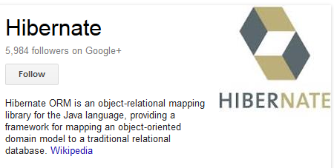
What is Hibernate?
Hibernate is an ORM (Object Relational Mapping) tool.
Maps the Relational Model in the database to the Object Model in Java.
Tables are mapped to classes.
Columns are mapped to JavaBean properties.
Replaces SQL with HQL, a database-independent query language that navigates object relations rather than table relations.

Slide 5
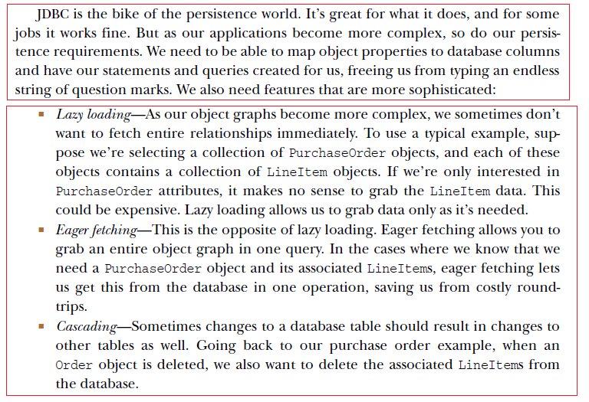
Why Hibernate?

Slide 6
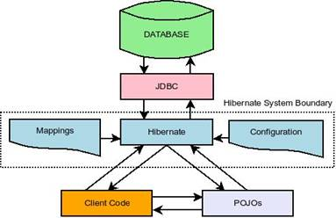
If ORM is the Solution, is JDBC a Problem?
No, no, JDBC is perfectly alright
ORM provides a layer of convenience for the programmer.
Does this convenience come with a price of performance?
ORM sits in between your application and JDBC providing the missing link between the object oriented model and relational database model of programming. In fact this so called ORM interacts with the JDBC to talk to the database ultimately.

Slide 7
Workshop topics
Hibernate-What it is ?
JPA- What it is?
ORM and Issues
Hibernate Hello World CRUD
Primary key generation strategy
More annotations
Hibernate Object life cycle
Hibernate Architecture
Relation mapping
Many-to-one mapping
one-to-one mapping
Many-to-Many mapping
Inheritance in Hibernate
Single Table Strategy
Table Per Class Strategy
Joined Strategy
HQL and the Query Object
one class to two tables
Select and Pagination in HQL
Named Quaries
Criteria API
Hibernate caching
First Level
Second Level Cache
Hibernate optimization
Hibernate Batch Processing

Slide 8
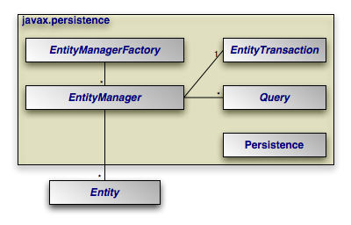
What is JPA?
JPA is the Java Persistence API, the entity persistence model for EJB 3.0
Standardized persistence framework which is implemented by Hibernate (or TopLink, Cayenne, etc.)
JPA Annotations and persistence.xml provide vendor independent configuration
EntityManager provides vendor independent access to persistence
Replaces vendor specific query languages (HQL) with standard (JPQL)

Slide 9
Why JPA?
JPA is the standard, and standards are good!
Using JPA does not tie you to Hibernate.
JPA gives you most of the features of plain old Hibernate, except:
No criteria queries in JPA 2.0 ☹
Criteria query is a neat feature of Hibernate that constructs query using Java-based combinators instead of alternate query language, getting the benefit of IntelliSense and Eclipse’s refactoring tools.
JPA doesn’t have Hibernate’s DeleteOrphan cascade type
Delete Orphan is a useful annotation that directs Hibernate to deletes entities in a collection if the parent is deleted, preventing orphaning.
JPA doesn’t have an equivalent to Hibernate’s ScrollableResults
But, all of these features are accessible to an otherwise fully JPA application!

Slide 10
Workshop topics
Hibernate-What it is ?
JPA- What it is?
ORM and Issues
Hibernate Hello World CRUD
Primary key generation strategy
More annotations
Hibernate Object life cycle
Hibernate Architecture
Relation mapping
Many-to-one mapping
one-to-one mapping
Many-to-Many mapping
Inheritance in Hibernate
Single Table Strategy
Table Per Class Strategy
Joined Strategy
HQL and the Query Object
one class to two tables
Select and Pagination in HQL
Named Quaries
Criteria API
Hibernate caching
First Level
Second Level Cache
Hibernate optimization
Hibernate Batch Processing

Slide 11
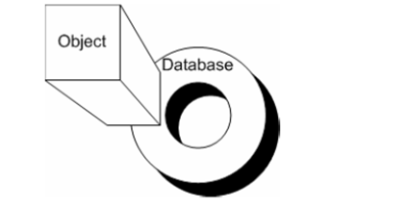
ORM
Object ←→Relational
Mapping object to relational world is not easy, as there are points of mismatches
There are numbers of impedance mismatches between OO world and DB worlds, and ORM tool must address and provide solutions for that
Identity
Granularity
Associations
Navigation
Inheritance
Data type mismatch

Slide 12

Identity
A row is uniquely identified form all other rows by its primary key
An object's identity does not always translate well to the concept of primary key of DB world
In Java, What is the meaning of identity of an object?
Its data or its place in memory?

Slide 13
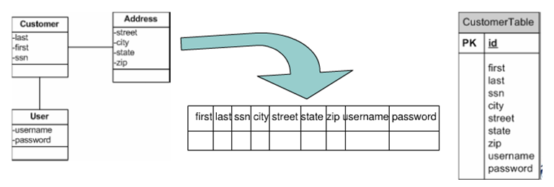
Granularity
Objects and tables are at different levels of granularity
Table structure are often de-normalized in order to support better performance, so table rows can map to multiple objects, how to map them?

Slide 14
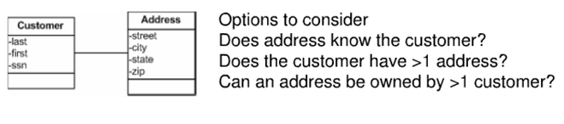
Associations
Associations in Java are either unidirectional or bidirectional and can be represented by one object having pointer of other object.
Relation between database tables is based on join. table relationship is always bidirectional, while for object it may be unidirectional/bidirectional

Slide 15
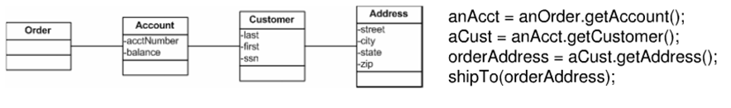
Navigation and associations traversal
Navigating Java Objects to get property information often require traversal of the object graph.
This can be quite expensive if the objects are distributed or need to be created before traversed.
Consider getting the address to ship and order
While navigation in database is handled with the help of single join.

Slide 16
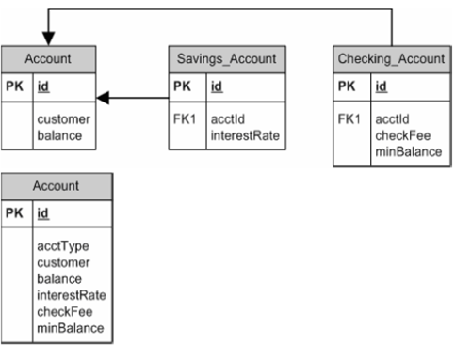
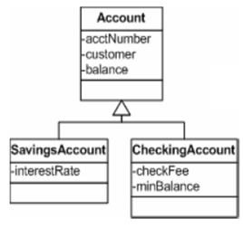
Inheritance
Inheritance and Polymorphism are important concepts in OO world
Database don't have equivalent concepts
Now question is how to map it to database world?
Inheritance examples

Slide 17
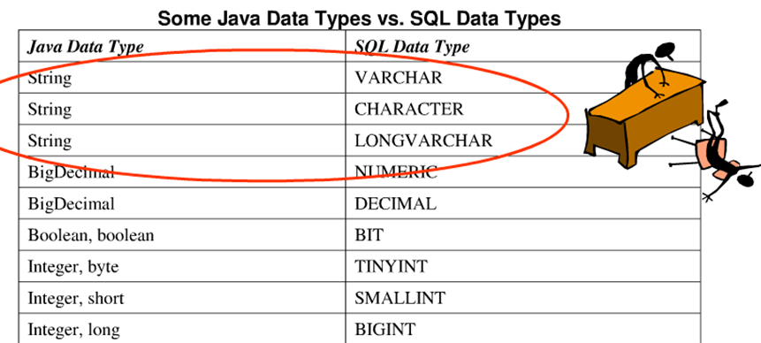
Data Types
There is mismatch between database data type and object oriented data types.
Question is how ORM tools can help us to map is correctly?

Slide 18
Workshop topics
Hibernate-What it is ?
JPA- What it is?
ORM and Issues
Hibernate Hello World CRUD
Primary key generation strategy
More annotations
Hibernate Object life cycle
Hibernate Architecture
Relation mapping
Many-to-one mapping
one-to-one mapping
Many-to-Many mapping
Inheritance in Hibernate
Single Table Strategy
Table Per Class Strategy
Joined Strategy
HQL and the Query Object
one class to two tables
Select and Pagination in HQL
Named Quaries
Criteria API
Hibernate caching
First Level
Second Level Cache
Hibernate optimization
Hibernate Batch Processing

Slide 19
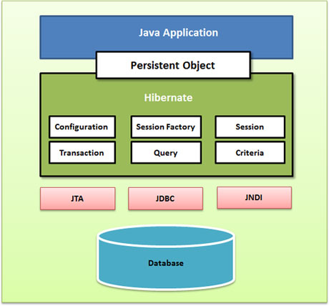
Hibernate Hello World
Steps
Write a POJO class representing the table
Write a hbm file
Write cfg file/ write annotated POJO class
Write a class to test CRUD code

Slide 20
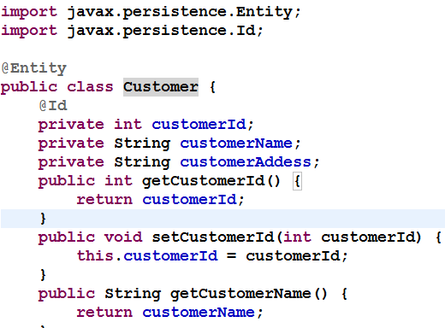
Write a Annotated POJO class
Note: annotations can also be applied to getters

Slide 21
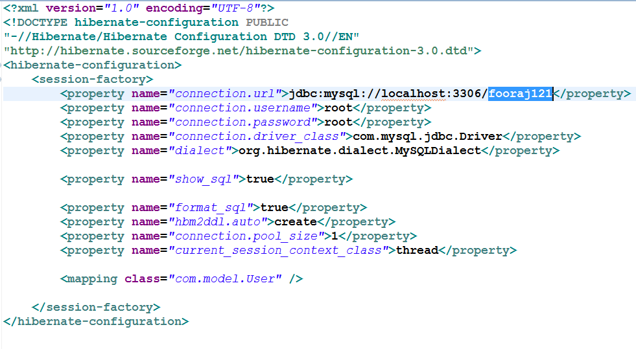
Hibernate.cfg.xml

Slide 22
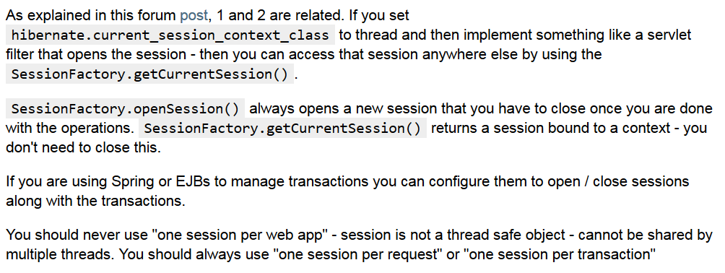
<property name="current_session_context_class">thread</property>
http://stackoverflow.com/questions/8046662/hibernate-opensession-vs-getcurrentsession
https://forum.hibernate.org/viewtopic.php?p=2384979&sid=8367751b54bf160003b867f858393398#p2384979

Slide 23
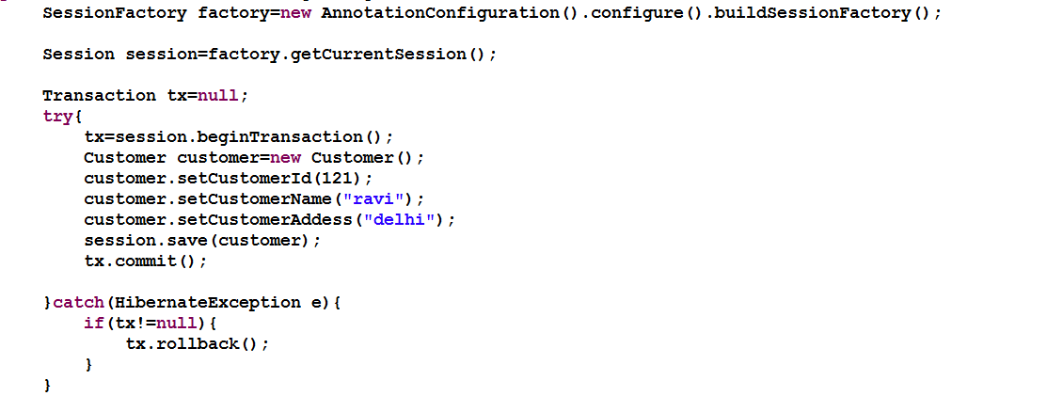

Adding record

Slide 24
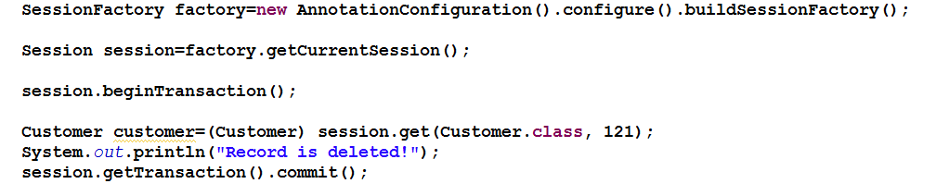
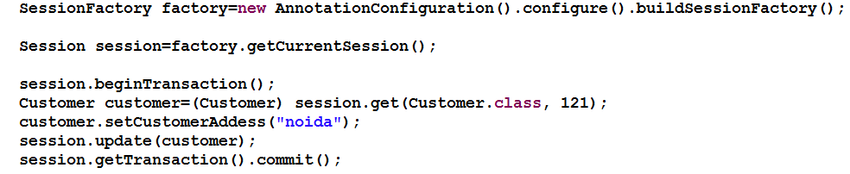
Deleting & Update record

Slide 25
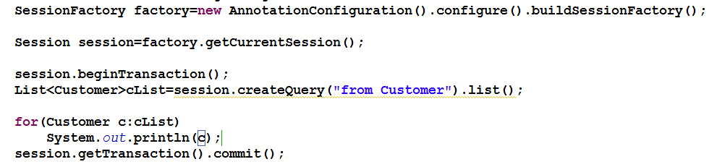
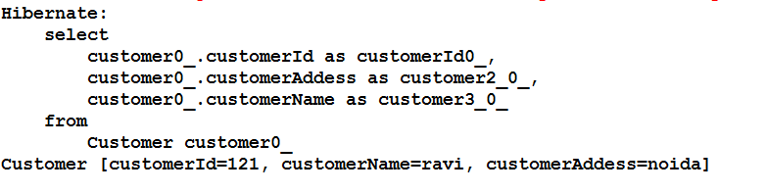
Display all records

Slide 26
Workshop topics
Hibernate-What it is ?
JPA- What it is?
ORM and Issues
Hibernate Hello World CRUD
Primary key generation strategy
More annotations
Hibernate Object life cycle
Hibernate Architecture
Relation mapping
Many-to-one mapping
one-to-one mapping
Many-to-Many mapping
Inheritance in Hibernate
Single Table Strategy
Table Per Class Strategy
Joined Strategy
HQL and the Query Object
one class to two tables
Select and Pagination in HQL
Named Quaries
Criteria API
Hibernate caching
First Level
Second Level Cache
Hibernate optimization
Hibernate Batch Processing

Slide 27
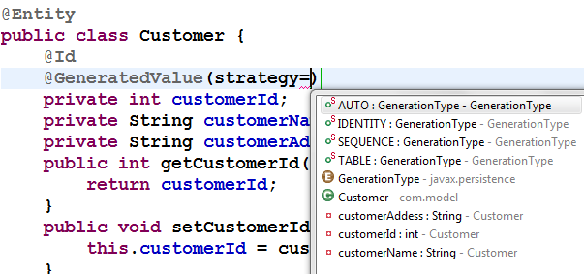
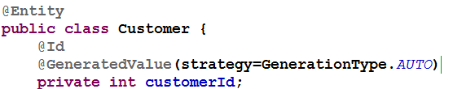
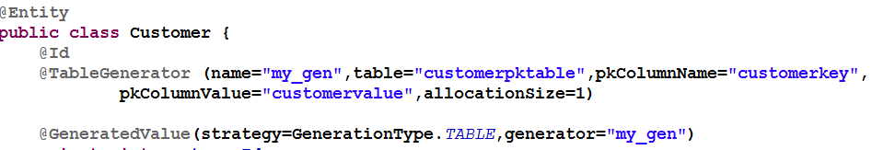
Primary Keys with @Id and @GeneratedValue
@GeneratedValue annotation is used to decide primary key generation strategies
This takes a pair of attributes: strategy and generator. The strategy attribute must be a value from the javax.persistence.GeneratorType enumeration. If you do not specify a generator type, the default is AUTO

Slide 28
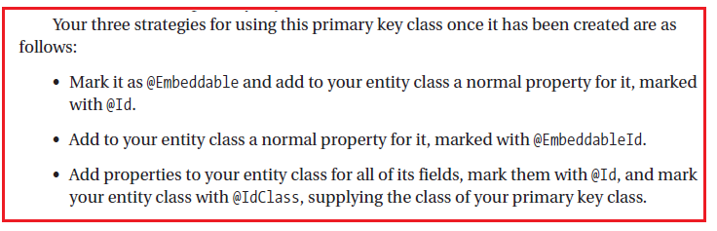
Compound Primary Keys
What if we need some business primary key?
You must create a class to represent the primary key.
Condition to be primary key class:
It must be a public class
It must have a default constructor
It must be serializable
It must implement hashCode() and equals() methods to allow the Hibernate code
Compound Primary Keys with @Id, @IdClass, or @EmbeddedId
Consider that business requirment is that we need to represent customer primary key as a combination of customerId and customerRegistrationId?

Slide 29
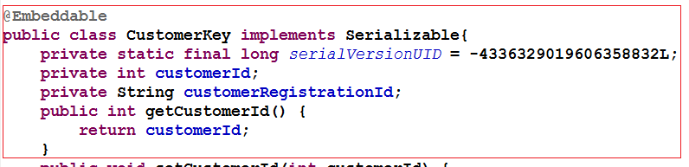
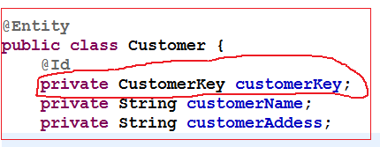
Compound Primary Keys with @Id
Create an POJO annotated with @Embeddable ( it must implements Serilizable interface and must have default constructor)
Use it in target class

Slide 30
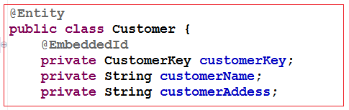
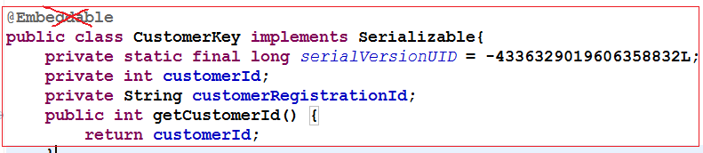
Compound Primary Keys @EmbeddedId
Here, the primary key class cannot be used in other tables since it is not an @Embeddable entity, but it does allow us to treat the key as a single attribute of the Account class
No need to mention @Embeddable on CustomerKey class

Slide 31
Workshop topics
Hibernate-What it is ?
JPA- What it is?
ORM and Issues
Hibernate Hello World CRUD
Primary key generation strategy
More annotations
Hibernate Object life cycle
Hibernate Architecture
Relation mapping
Many-to-one mapping
one-to-one mapping
Many-to-Many mapping
Inheritance in Hibernate
Single Table Strategy
Table Per Class Strategy
Joined Strategy
HQL and the Query Object
one class to two tables
Select and Pagination in HQL
Named Quaries
Criteria API
Hibernate caching
First Level
Second Level Cache
Hibernate optimization
Hibernate Batch Processing

Slide 32
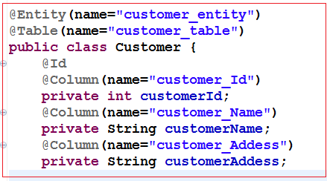
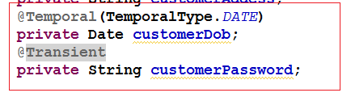
More Annotations
What if table name and field name is something else?
Use annotation @Table,@Column
@Tomporal
@Lob?
@Tomporal?
Storing date and time.
What if i want only to store date part not time?
@Temporal(TemporalType.DATE)
@Transient?
You can not store static and transient data.
@Basic ?
Used to add some properties to add to that field.
You can work apply without it.
What is the difference bw applying name using @Table and @Entity

Slide 33
Workshop topics
Hibernate-What it is ?
JPA- What it is?
ORM and Issues
Hibernate Hello World CRUD
Primary key generation strategy
More annotations
Hibernate Object life cycle
Hibernate Architecture
Relation mapping
Many-to-one mapping
one-to-one mapping
Many-to-Many mapping
Inheritance in Hibernate
Single Table Strategy
Table Per Class Strategy
Joined Strategy
HQL and the Query Object
one class to two tables
Select and Pagination in HQL
Named Quaries
Criteria API
Hibernate caching
First Level
Second Level Cache
Hibernate optimization
Hibernate Batch Processing

Slide 34
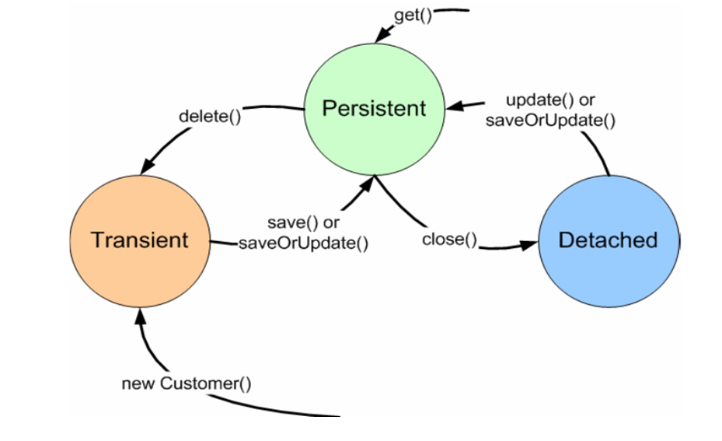
Object lifecycle
Given an instance of an object that is mapped to Hibernate, it can be in any one of three states:-
Transient
Persistence
Detached

Slide 35
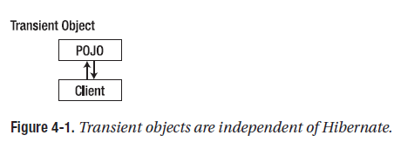
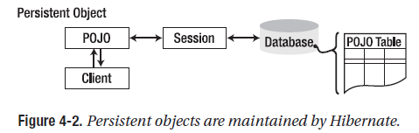
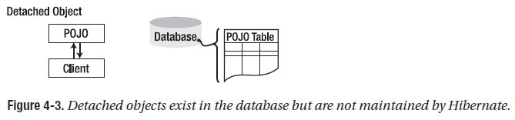
More on Object Life Cycle
Transient objects exist in memory, Hibernate does not manage transient objects or persist changes to transient objects. Hibernate Don’t care about that object
Persistent objects exist in the database, and Hibernate manages the persistence for persistent objects. If fields or properties change on a persistent object, Hibernate will keep the database representation up-to-date.
Detached objects have a representation in the database, but changes to the object will not be reflected in the database, and vice versa.
A detached object can be created by closing the session that it was associated with, or by evicting it from the session with a call to the session’s evict() method.

Slide 36
Workshop topics
Hibernate-What it is ?
JPA- What it is?
ORM and Issues
Hibernate Hello World CRUD
Primary key generation strategy
More annotations
Hibernate Object life cycle
Hibernate Architecture
Relation mapping
Many-to-one mapping
one-to-one mapping
Many-to-Many mapping
Inheritance in Hibernate
Single Table Strategy
Table Per Class Strategy
Joined Strategy
HQL and the Query Object
one class to two tables
Select and Pagination in HQL
Named Quaries
Criteria API
Hibernate caching
First Level
Second Level Cache
Hibernate optimization
Hibernate Batch Processing

Slide 37
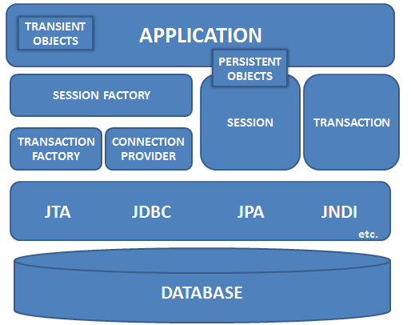
Hibernate Architecture

Slide 38
Core Interfaces
Used to perform basic CRUD and querying operations
Session
SessionFactory
Configuration
Transaction interface
Query
Criteria

Slide 39

SessionFactory
The application obtains Session instances from a SessionFactory interface
The SessionFactory is created from an configuration object.
The SessionFactory is an expensive object to create
It too is created at application start-up time
It should be created once and kept for latter use.
The SessionFactory object is used by all the threads of an applications
it is thread safe object
one SessionFactory object is created per database (where connecting to multiple sessions)
The SessionFactory is used to create Session Objects

Slide 40
Session
The Session object is created from the SessionFactory object
A Session object is lightweight and inexpensive to create.
Session object provides the main interface to accomplish work with the database
Does the work of getting a physical connection to the database (hopefully from a connection pool)
Session objects are not thread safe
Session objects should not be kept open for a long time
Application create and destroy these as needed. Typically they are created to complete a single unit of work.
When modifications are made to the database, session objects are used to create a transaction object

Slide 41

Transaction
Transaction objects are obtained from the session objects, when an modification to the database is needed.
The Transaction object provides abstraction for the underlying implementation
Hibernate with use whatever transaction implementation is available (JDBC, JTA etc.)
It is optional; allowing developer to use their own transactional infrastructure.
Transaction objects should be kept open for a short time.

Slide 42
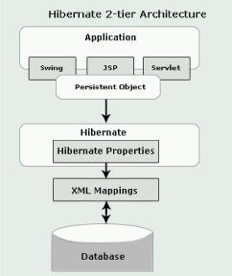
How hibernate actually works with JDBC?
By default Hibernate creates a proxy for each of the entity class in mapping file. This class contain the code to invoke JDBC.
Proxies are created dynamically by sub-classing the entity object at runtime.
The subclass has all the methods of the parent, so when a method on the entity object is called, the proxy loads up the data from the database and calls the method.

Slide 43
Persistent object states
The POJO or persistent objects can be in one of the three states is defined in relation to a persistence context (that means it is loaded into the Hibernate Session object)
Transient
Persistent
Detached

Slide 44
Transient state
The instance is not associated with any persistence context. It has no persistent identity or primary key value.
Transient instances may be made persistent by calling save(), persist() or saveOrUpdate() method on Session object

Slide 45
Why two method for save?
Two method to save– save() and persist()
With save() the insert statement is executed immediately regardless of transaction state. It returns the inserted key so you can do something like this:
long newKey = session.save(myObj); So use save() if you need an identifier assigned to the persistent instance immediately.
With persist(), the insert statement is executed in a transaction, not necessarily immediately. This is preferable in most cases.
Use persist() if you don't need the insert to happen out-of-sequence with the transaction and you don't need the inserted key returned.

Slide 46
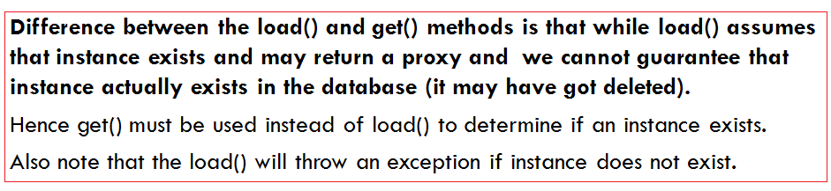
Different between get() and load()
both functions are use to retrieve an object with different mechanism
session.load()
It will always return a “proxy” (Hibernate term) without hitting the database.
proxy object look like a temporary fake object.
If no row found , it will throws an ObjectNotFoundException.
session.get()
It always hit the database and return the real object,an object that represent the database row, not proxy.
If no row found , it return null.

Slide 47
Detached State
The instance was once associated with a persistence context/session but not is not attached to it may because the session was closed.
It has a persistent identity and can have a corresponding row in the database.
While for persistent instance Hibernate guarantees the relationship between persistent (database ) identity and Java identity for detached instance there is no such guarantees .
Detached instances may be made persistent by calling update(), saveOrUpdate()
The state of a transient or detached instance may also be made persistent as a new persistent instance by calling merge().

Slide 48
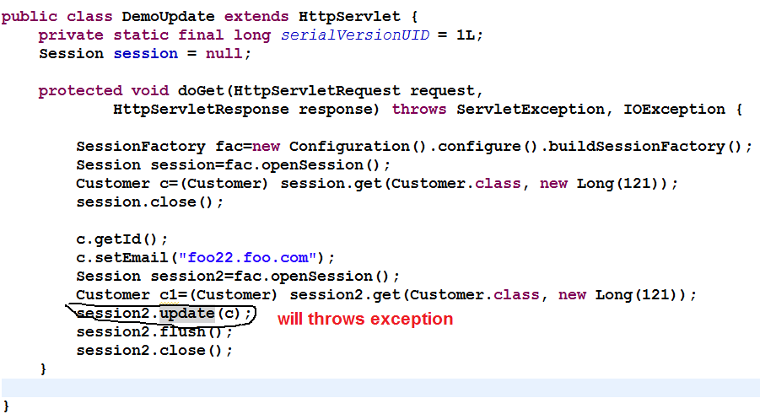
update(),merge() differences
Update should be used to save the data when the session does not contain an already persistent instance with the same identifier.
Merge should be used to save the modifications at any time without knowing about the state of a session
To understand difference bw update() and merge() lets try to update values inserted earlier in servlet…

Slide 49
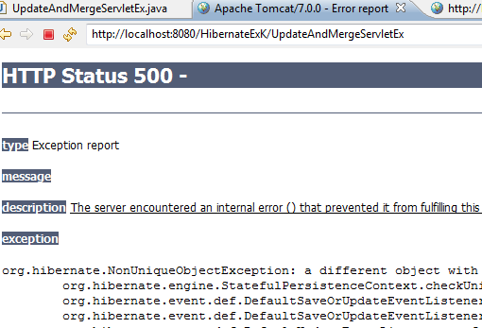

When
session2.update(c); is used instead of
session2.merge(c);
This is if there is a persistent instance with the same identifier in the session, update() will throw an exception!
When session2.merge(c);
is used the data gets updated because the instance that the session is holding gets its values from the detached instance when merge is called on detached instance.

Slide 50
delete() and refresh()
void delete(Object object) throws HibernateException
Remove a persistent instance from the datastore. The argument may be an instance associated with the receiving Session or a transient instance with an identifier associated with existing persistent state. This operation cascades to associated instances if the association is mapped with cascade="delete".
void refresh(Object object) throws HibernateException
This method is useful to sync the state of the given instance with underlying database in cases where there are chances that database might have been altered outside the application as a result of a trigger. This is also useful in cases where direct SQL is used by the application to update the data.

Slide 51
flush(), close(), clear()
void flush() throws HibernateException
This is the method that actually synchronizing the underlying database with persistent object held in session memory.
This should be called at the end of a unit of work, before committing the transaction and closing the session (depending on flush-mode, Transaction.commit() calls this method).
Connection close() throws HibernateException
End the session by releasing the JDBC connection and cleaning up. It is not strictly necessary to close the session but at least it must be disconnected by calling disconnect()
void clear()
Completely clear the session. Evict all loaded instances and cancel all pending saves, updates and deletions. Do not close open iterators or instances of ScrollableResults.

Slide 52
Transaction
Transaction can be set using the methods of Session.
Transaction beginTransaction() throws HibernateException
If Transaction object is associated with the session return that else create a new transaction.
Transaction getTransaction()
Get the Transaction instance associated with this session
In both the cases the class of the returned Transaction object is determined by the property hibernate.transaction_factory.
The most common approach is the session-per-request pattern where a single Hibernate Session has same scope as a single database transaction.
The Hibernate session can be used for multiple DB operations (save, query, update) within the same request.

Slide 53
Transaction methods
void begin() throws HibernateException
void commit() throws HibernateException
void rollback() throws HibernateException
To check if transactions was committed or rolled-back properly
boolean wasRolledBack() throws HibernateException
boolean wasCommitted() throws HibernateException
Code snippet wrapping statements in a transactions:
Session sess = factory.openSession();
Transaction tx;
try
{
tx = sess.beginTransaction();
//do some work ...
tx.commit();
}
catch (Exception e)
{
if (tx!=null) tx.rollback(); throw e; }
finally { sess.close(); }

Slide 54
Workshop topics
Hibernate-What it is ?
JPA- What it is?
ORM and Issues
Hibernate Hello World CRUD
Primary key generation strategy
More annotations
Hibernate Object life cycle
Hibernate Architecture
Component Mapping
Relation mapping
Many-to-one mapping
one-to-one mapping
Many-to-Many mapping
Inheritance in Hibernate
Single Table Strategy
Table Per Class Strategy
Joined Strategy
HQL and the Query Object
one class to two tables
Select and Pagination in HQL
Named Quaries
Criteria API
Hibernate caching
First Level
Second Level Cache
Hibernate optimization
Hibernate Batch Processing

Slide 55
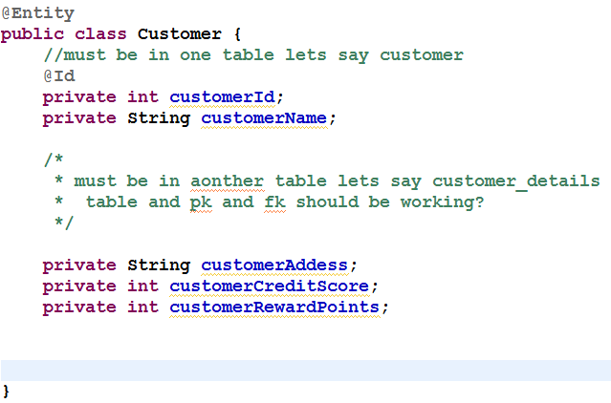
One class to two tables
Let we want to store the object of customer in two different tables?
We have to decide what should be the tables names?
Lets say Customer and other other table CustomerDetails
We have to decide what fields should go in each tables?
How to represent this semantics???

Slide 56
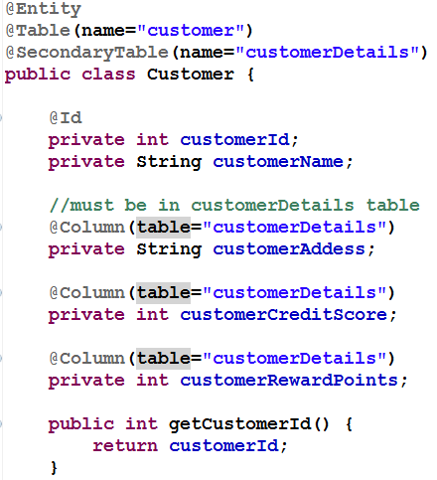
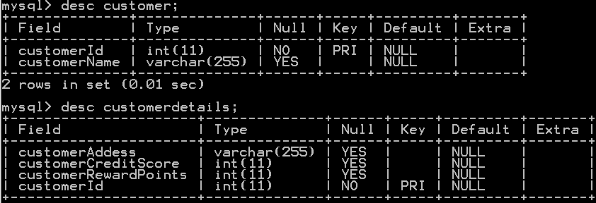
One class to two tables: solutions
SecondaryTable annotation is the key!!!

Slide 57
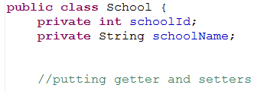
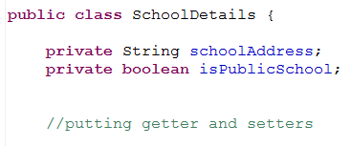
One table from two classes
Want to have one table for two classes…..
What to do?

Slide 58
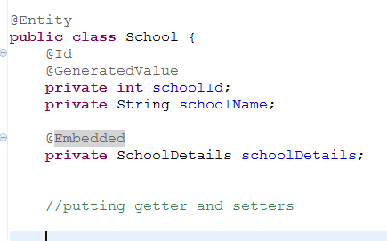
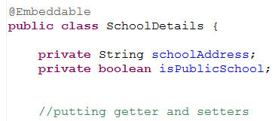
One table from two classes: Solutions
1. put ref of SchoolDetails in School class (embedded class)
2. declare SchoolDetails as embedded class
3. Declare SchoolDetails as @Embeddable (dont declare it @Entity)

Slide 59
Workshop topics
Hibernate-What it is ?
JPA- What it is?
ORM and Issues
Hibernate Hello World CRUD
Primary key generation strategy
More annotations
Hibernate Object life cycle
Hibernate Architecture
Component Mapping
Relation mapping
Many-to-one mapping
one-to-one mapping
Many-to-Many mapping
Inheritance in Hibernate
Single Table Strategy
Table Per Class Strategy
Joined Strategy
HQL and the Query Object
one class to two tables
Select and Pagination in HQL
Named Quaries
Criteria API
Hibernate caching
First Level
Second Level Cache
Hibernate optimization
Hibernate Batch Processing

Slide 60

Relationship Mapping
Most of time we required to map relationship between entities
Every relationship has four characteristics:
Directionality: Unidirectional vs Bidirectional ?
Role: Each entity in the relationship is said to play a role. Depending on directionality, we can identity the entity playing the role of sources and entity playing the role of target
Cardinality: The number of entity instances that exists on each side of the relationship
Ownership: One of the two entities in the relationship is said to own the relationship. Employee is called owner of relationship and Department is called reverse-owner of relationship

Slide 61
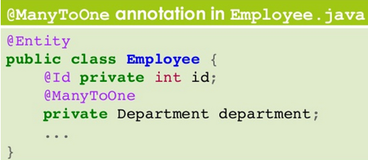
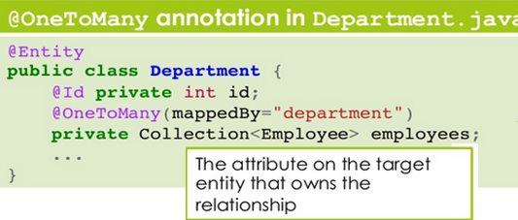
Many-to-one mapping
In an Many-to-one mapping the owner of the relationship is the source entity.
A Many-to-one mapping is defined by annotating the source entity with @ManyToOne annotation

Slide 62
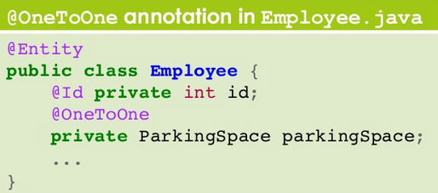
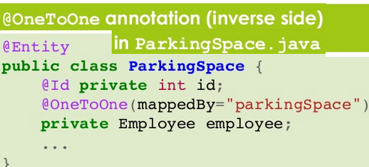
one-to-one mapping
In a one-to-one mapping the owner can be either the source entity or the target entity.
one-to-one mapping is defined by annotating the owner entity with the @OneToOne annotations
If the one-to-one mapping is bidirectional the inverse side of the relationship need to be specified too
In the non owner entity, the @OneToOne annotations must come with the mappedBy element

Slide 63


Many-to-Many mapping
In a Many-to-Many mapping there is no join column . The only way to implement such a mapping is by means of a join table
Therefore, we can arbitrarily specify as owner either the source entity or the target entity
If the many-to-many mapping is bi-directional, the inverse side of the relationship need to be specified too.
In the non owner entity the @ManyToMany annotation must come with mappedBy elements

Slide 64

Lazy Loading
The performance can be optimized by deferring the fetching of such data until they are actually needed. This design pattern is called lazy loading
At relationship level, lazy loading can be of great help in enhancing performance because it can reduce the amount of SQL get executed.
the fetch mode can be specified on any of the four relationship mapping types
The parkingSpace attributers may not be loaded each time employee is loaded.

Slide 65
When the fetch mode is not specified
On a single valued relationship the related object is guaranteed to be loaded eagerly and Collection-valued relationship default to be lazily loaded
In case of bi-directional relationship the mode might be lazy on one side but eager on the other
Quite common situation, relationship are often accessed in different way depending on the direction from which navigation occurs.
The directive to lazily fetch an attribute is meant only to be hint to the persistence provider
The provider is not required to respect the request as the behaviour of the entity will not be compromised if the provider decides to eagerly load data.
The converse is not true because specifying that an attributes be eagerly fetched might be critical to access the entity once detached.

Slide 66

Cascading operations
Hibernate/JPA provides a mechanism to define when operations such as save()/persist() should be automatically cascaded across relationships
You need to be sure that Address instance bas been set on Employee instance before invoking persist() on it.
The cascade attribute accepts several possible values coming from the cascade Type enumerations
PERSIST, REFRESH, REMOVE, MERGE and DETACH
The constant ALL is a shorthand for declaring that all five operations should be cascaded.
As for relationship, cascade settings are unidirectional
They must be explicitly set on both sides of a relationship if the same behaviours is intended for both situations.

Slide 67
Workshop topics
Hibernate-What it is ?
JPA- What it is?
ORM and Issues
Hibernate Hello World CRUD
Primary key generation strategy
More annotations
Hibernate Object life cycle
Hibernate Architecture
Component Mapping
Relation mapping
Many-to-one mapping
one-to-one mapping
Many-to-Many mapping
Inheritance in Hibernate
Single Table Strategy
Table Per Class Strategy
Joined Strategy
HQL and the Query Object
one class to two tables
Select and Pagination in HQL
Named Quaries
Criteria API
Hibernate caching
First Level
Second Level Cache
Hibernate optimization
Hibernate Batch Processing

Slide 68

Mapping Inheritance
Inheritance can be used also for persistent objects, for factoring out data members inherited by multiple subclasses
The mapping of a hierarchy to the database can follow different strategies: -
–Single table per hierarchy
–Table per class
–Joined

Slide 69
Inheritance
Table per class hierarchy
Here only one table is going to be created, all fields mapped to single table.
Not very memory efficient, May be faster
Table per class
Separate table mapped to all classes in the hierarchy
Three table is created Account, SavingAccount, CurrentAccount
Table per concrete class
Here Account class is an abstract class. So no need to map it to database, the values mapped by sub classes ie SavingAccount and CurrentAccount
Two separate table is going to be created for SavingAccount and CurrentAccount

Slide 70




Table per class hierarchy

Slide 71




Table per class

Slide 72
Workshop topics
Hibernate-What it is ?
JPA- What it is?
ORM and Issues
Hibernate Hello World CRUD
Primary key generation strategy
More annotations
Hibernate Object life cycle
Hibernate Architecture
Component Mapping
Relation mapping
Many-to-one mapping
one-to-one mapping
Many-to-Many mapping
Inheritance in Hibernate
Single Table Strategy
Table Per Class Strategy
Joined Strategy
HQL and the Query Object
Select and Pagination in HQL
Named Quarries
Criteria API
Hibernate caching
First Level
Second Level Cache
Hibernate optimization
Hibernate Batch Processing

Slide 73
HQL
HQL is OO version of SQL
HQL uses class name instead of table name, and property names instead of column name
HQL fully supports polymorphic queries
Way to pulling data from the database in the Hibernate.
Using session methods(get() and load() methods)
limited control to accessing data
Using HQL & Native HQL
Slightly more control using where clause
Using Criteria API
The criteria API is an alternative of HQL queries.
It is more powerful and flexible for writing tricky criteria functions and dynamic queries

Slide 74
HQL Syntax
HQL Queries elements:
Clauses, Aggregate functions, Subqueries
Clauses in the HQL are:
from, select, where, order by, group by
Aggregate functions are:
avg(...), sum(...), min(...), max(...) , count(*)
count(...), count(distinct ...), count(all...)

Slide 75


Hello World HQL

Slide 76

HQL Insert Query Example
In HQL, only the INSERT INTO … SELECT … is supported; there is no INSERT INTO … VALUES.
HQL only support insert from another table. For example

Slide 77


Native SQL queries
In Hibernate, HQL or criteria queries should be able to let you to execute almost any SQL query you want.
However, many developers are complaint about the Hibernates generated SQL statement is slow and more prefer to generated their own SQL (native SQL) statement
Hibernate provide a createSQLQuery method to let you call your native SQL statement directly.
In this example, you tell Hibernate to return you a Stock.class, all the select data (*) will match to your Stock.class properties automatically.

Slide 78


Named Quarries
Give unique name to the Queries that work for entire application.
The application can use the query by using the name of the query

Slide 79


Criteria API in Hibernate
The criteria API is an alternative of HQL queries.
It is more powerful and flexible for writing tricky criteria functions and dynamic queries
http://stackoverflow.com/questions/197474/hibernate-criteria-vs-hql

Slide 80


Criteria API in Hibernate

Slide 81

Criteria API in Hibernate

Slide 82
Workshop topics
Hibernate-What it is ?
JPA- What it is?
ORM and Issues
Hibernate Hello World CRUD
Primary key generation strategy
More annotations
Hibernate Object life cycle
Hibernate Architecture
Component Mapping
Relation mapping
Many-to-one mapping
one-to-one mapping
Many-to-Many mapping
Inheritance in Hibernate
Single Table Strategy
Table Per Class Strategy
Joined Strategy
HQL and the Query Object
Select and Pagination in HQL
Named Quarries
Criteria API
Hibernate caching
First Level
Second Level Cache
Hibernate optimization
Hibernate Batch Processing

Slide 83


Hibernate caching
Caching is a facility provided by ORM frameworks which help users to get fast running web application, while help framework itself to reduce number of queries made to database in a single transaction.
Fist level cache in hibernate is enabled by default and you do not need to do anything to get this functionality working. In fact, you can not disable it even forcefully.
First level cache is provided by Session Object. First level cache associated with session object is available only till session object is live. It is available to session object only and is not accessible to any other session object in any other part of application.

Slide 84
Important facts about primary caching
First level cache is associated with “session” object and other session objects in application can not see it.
The scope of cache objects is of session. Once session is closed, cached objects are gone forever.
First level cache is enabled by default and you can not disable it.
When we query an entity first time, it is retrieved from database and stored in first level cache associated with hibernate session.
If we query same object again with same session object, it will be loaded from cache and no sql query will be executed.
The loaded entity can be removed from session using evict() method. The next loading of this entity will again make a database call if it has been removed using evict() method.
The whole session cache can be removed using clear() method. It will remove all the entities stored in cache.

Slide 85


Primary caching
Primary caching is by default and you can not disable it.
What if you try to load same object in one session , hibernate don’t hit database twice, in fact it will hit database first time and put result in cache so that if next time it is request it can be provided from cache.
As you can see that second “session.load()” statement does not execute select query again and load the Customer entity directly.

Slide 86


First level cache case II
First level cache retrieval example with new session
With new session, entity is fetched from database again irrespective of it is already present in any other session in application.

Slide 87

Removing cache objects
How to remove from first level cache?
Though we can not disable the first level cache in hibernate, but we can certainly remove some of objects from it when needed. This is done using two methods :
evict()
clear()

Slide 88

Hibernate second level
second level cache is created in session factory scope and is available to be used in all sessions which are created using that particular session factory.
It means that once session factory is closed, all cache associated with it die and cache manager also closed down.
Further, It also means that if you have two instances of session factory (normally no application does that), you will have two cache managers in your application and while accessing cache stored in physical store, you might get unpredictable results like cache-miss.

Slide 89
How second level cache works
Whenever hibernate session try to load an entity, the very first place it look for cached copy of entity in first level cache (associated with particular hibernate session).
If cached copy of entity is present in first level cache, it is returned as result of load method.
If there is no cached entity in first level cache, then second level cache is looked up for cached entity.
If second level cache has cached entity, it is returned as result of load method. But, before returning the entity, it is stored in first level cache also so that next invocation to load method for entity will return the entity from first level cache itself, and there will not be need to go to second level cache again.
If entity is not found in first level cache and second level cache also, then database query is executed and entity is stored in both cache levels, before returning as response of load() method.
Second level cache validate itself for modified entities, if modification has been done through hibernate session APIs.
If some user or process make changes directly in database, the there is no way that second level cache update itself until “timeToLiveSeconds” duration has passed for that cache region. In this case, it is good idea to invalidate whole cache and let hibernate build its cache once again. You can use below code snippet to invalidate whole hibernate second level cache.

Slide 90
Hibernate caching with EhCache

Slide 91
Workshop topics
Hibernate-What it is ?
JPA- What it is?
ORM and Issues
Hibernate Hello World CRUD
Primary key generation strategy
More annotations
Hibernate Object life cycle
Hibernate Architecture
Component Mapping
Relation mapping
Many-to-one mapping
one-to-one mapping
Many-to-Many mapping
Inheritance in Hibernate
Single Table Strategy
Table Per Class Strategy
Joined Strategy
HQL and the Query Object
Select and Pagination in HQL
Named Quarries
Criteria API
Hibernate caching
First Level
Second Level Cache
Hibernate optimization
Hibernate Batch Processing

Slide 92
Workshop topics
Hibernate-What it is ?
JPA- What it is?
ORM and Issues
Hibernate Hello World CRUD
Primary key generation strategy
More annotations
Hibernate Object life cycle
Hibernate Architecture
Component Mapping
Relation mapping
Many-to-one mapping
one-to-one mapping
Many-to-Many mapping
Inheritance in Hibernate
Single Table Strategy
Table Per Class Strategy
Joined Strategy
HQL and the Query Object
Select and Pagination in HQL
Named Quarries
Criteria API
Hibernate caching
First Level
Second Level Cache
Hibernate optimization
Hibernate Batch Processing

